Slide 1












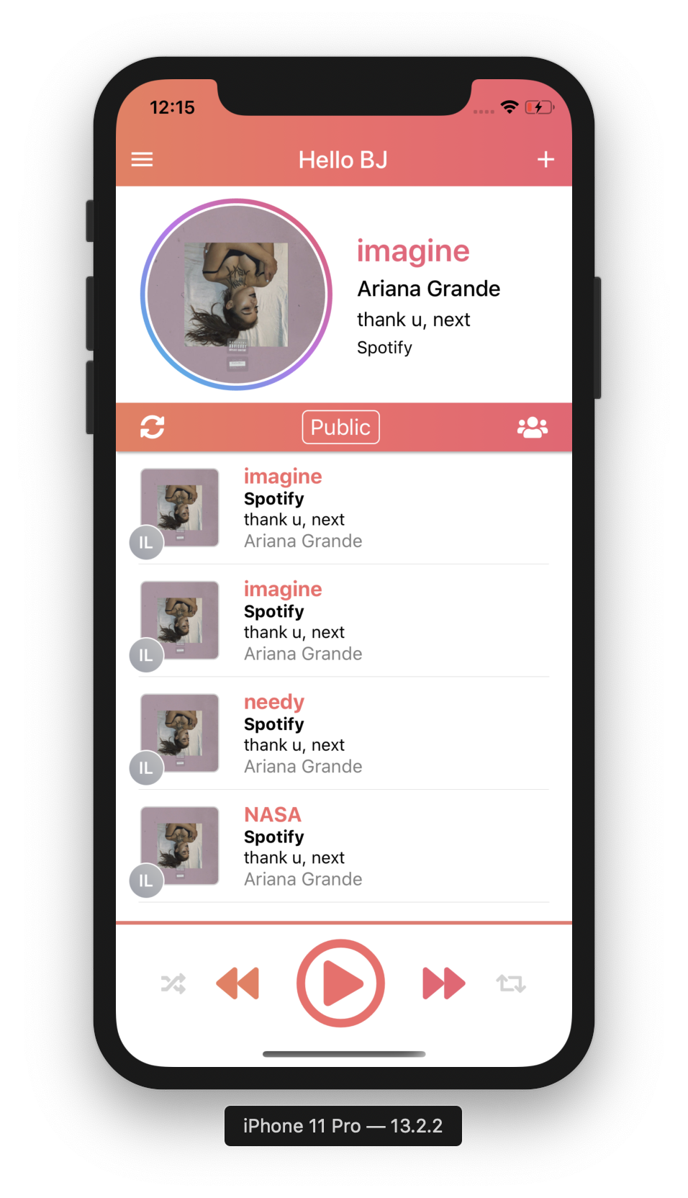
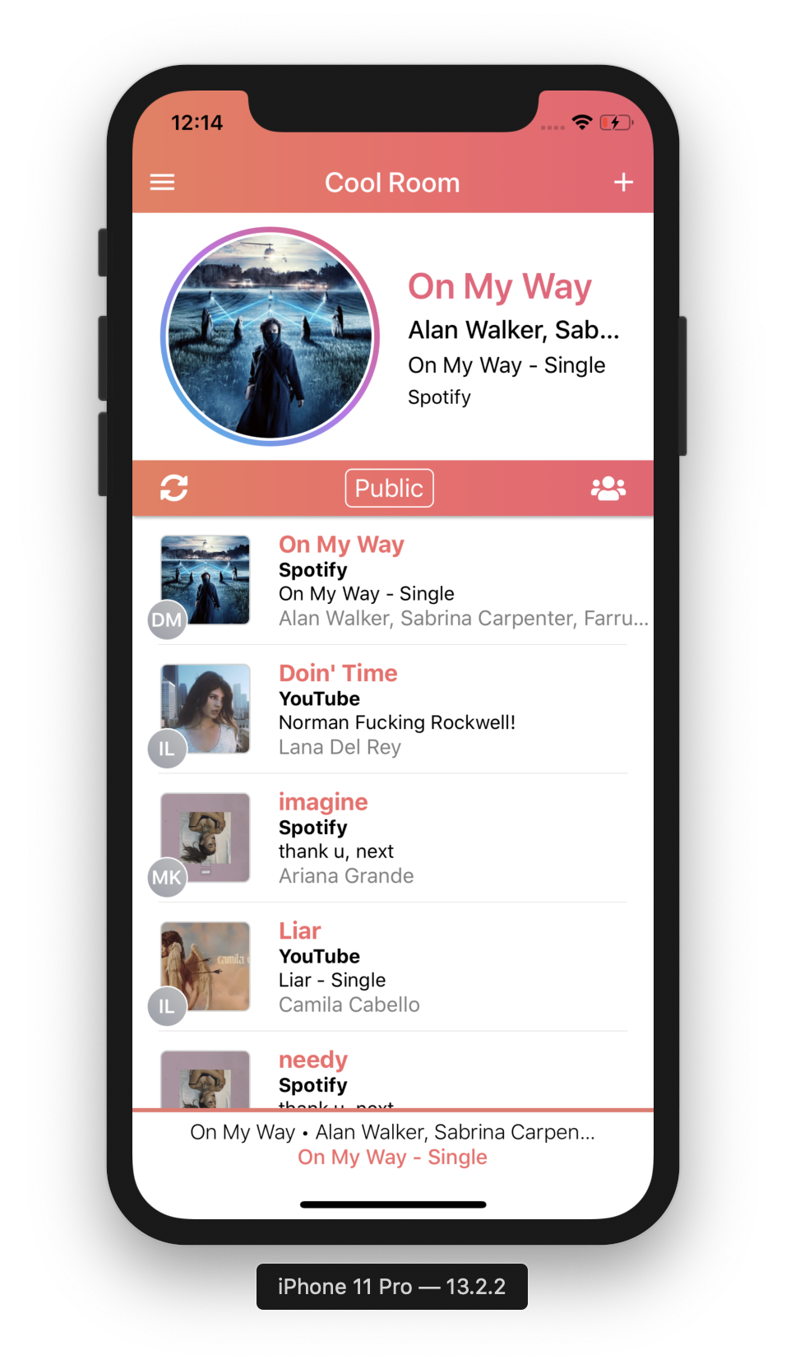

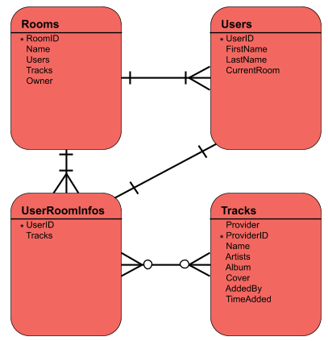


What is Amplify?
Amplify is a community music streaming service that will allow users to create and join rooms that host public music playlists using Spotify and YouTube services. Users will be able to join rooms and add songs of their choice to the community queue, which will be cycled through in round-robin style between all users’ queued songs.
Amplify will also have features useful to an individual user; the user will be able to import multiple playlists and rotate through those playlists via round-robin style.
Why Amplify?
We wanted to create a service that made the experience of sharing music with your friends easier and more accessible to people. Instead of struggling to pass one phone around to multiple people. Everyone can access the playlist from their own device and add songs from there!
How to get it?
Amplify is both IOS and Android compatible.
Technologies used
Database Diagram
Challenges
Learning to work with AWS
Working with the Android Emulator
Working with the YouTube and Spotify APIs
Developers
Alexia Filler, Ben Kern, Ian Lizarda, Donovan Moini and Serena Zafiris
Admin View
Guest View
Notes:
Title: Self-explanatory title of your project
Your name: This item needs to appear somewhere on the poster; usually it is accompanied by a reference to the class, CMSI 402, but that is optional.
LMU Logo: This item is NOT optional, and should be in one of the corners, usually one of the top corners of the poster.
Minimalistic content: Try to make the content describe the project without being too wordy. The idea is to be "parsimonious" with your text. You don't want to put so much on the poster that the audience needs to squint to read it.…But not too minimal:
Poster content: Here is the "meat" of the activity. You should provide an overview of the project purpose, its operation, and its main components or technologies. It is better to describe what the technologies are used for, rather than just making a bullet list of what you used. The overview should state the objective of the project, so that the intent is clear.
Graphics: Try to put at least two graphics on the poster. A good candidates for use is a screen shot of what the project looks like on an actual user interface screen (NOT the opening log in screen…) while the application is running. Another good idea would be a screen shot of some sort of logo if you have one.
Citations: If you have used any work from any other source, be sure to cite it in small text at the very bottom of the page. If there are multiple sources, do a "References" block at the end of the very last part of your text.
Language use: Try to keep the language as simple as possible to fully describe the workings of your project, but include enough technical detail to make it interesting and to properly reflect the work.
Spelling and grammar: ALWAYS check to make sure your poster is error-free — this is a critical part of any professional presentation!

